Slide 1


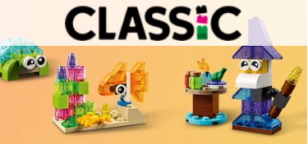



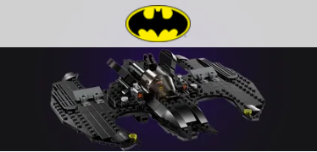






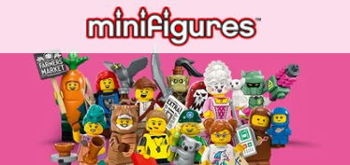
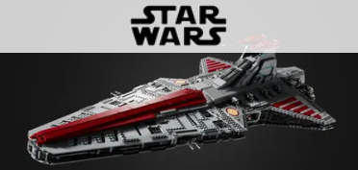





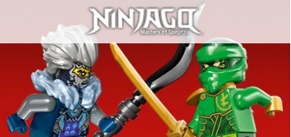
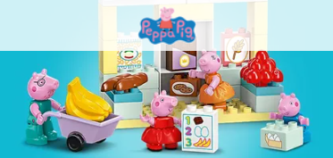
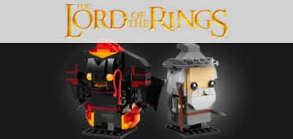
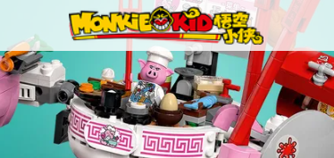
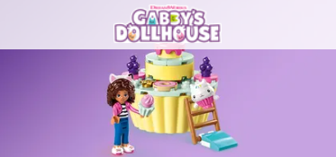


THEMES OVER TIME
How has the growth of the Lego changed over time?

Slide 2
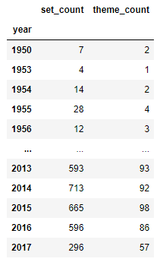
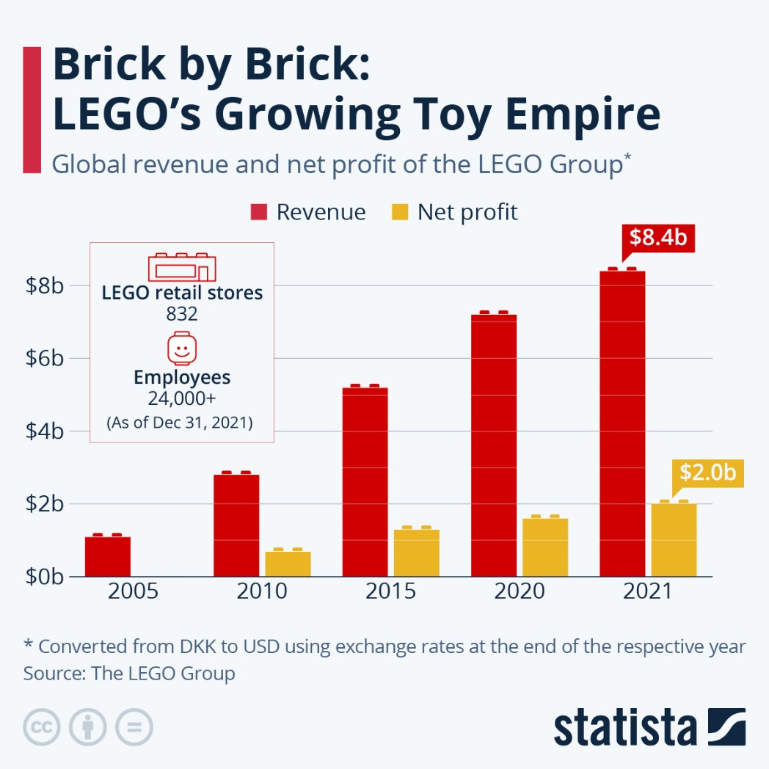
Where did we begin, and where did we end?

Slide 3
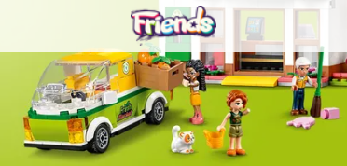
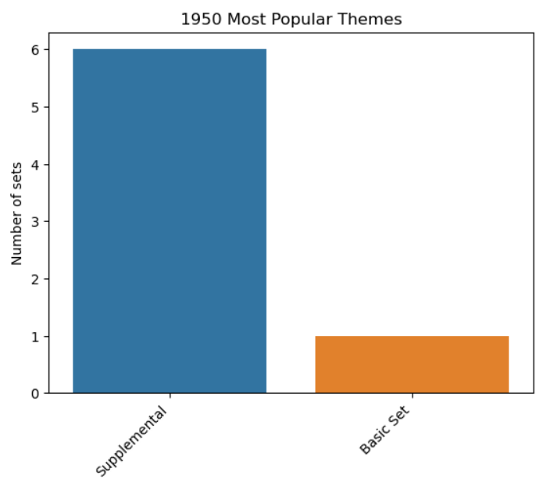
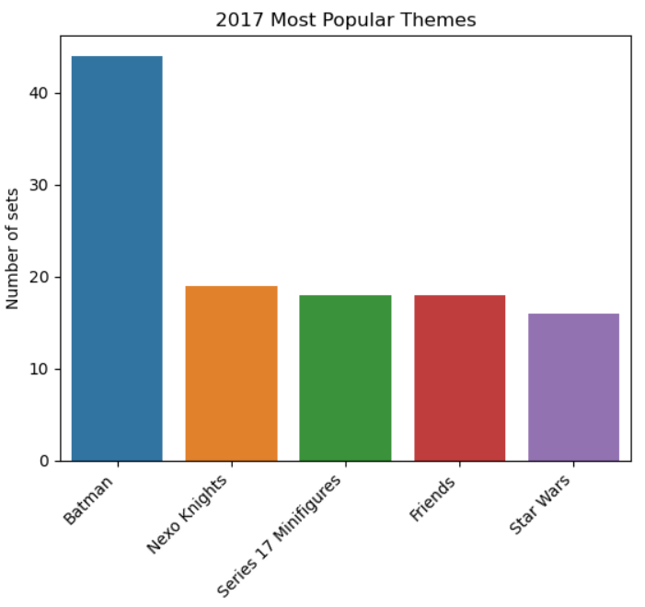
Sets per bestselling theme

Slide 4
What is “Supplemental”?
2 x 2 Curved Bricks | 1957
Motor Set with Rubber Tracks | 1969
4.5V Motor Set | 1976
Town Mini-Figures | 1978
Space Mini-Figures | 1979
Storage Cloth (Spread Bag) | 1980
Building Cards - 1030 | 1983
Building Cards - 1032 | 1985
Teachers Resource Set | 1985

Slide 5
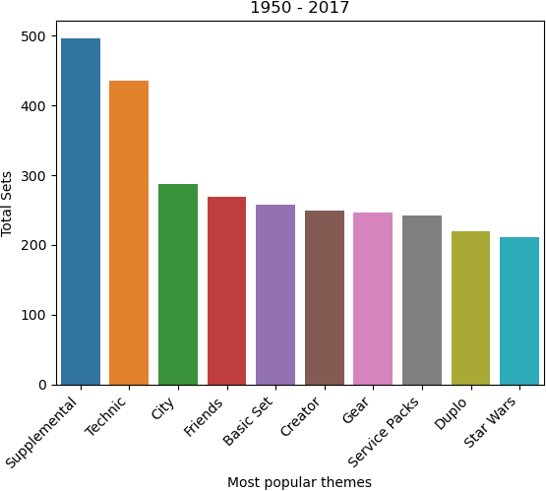
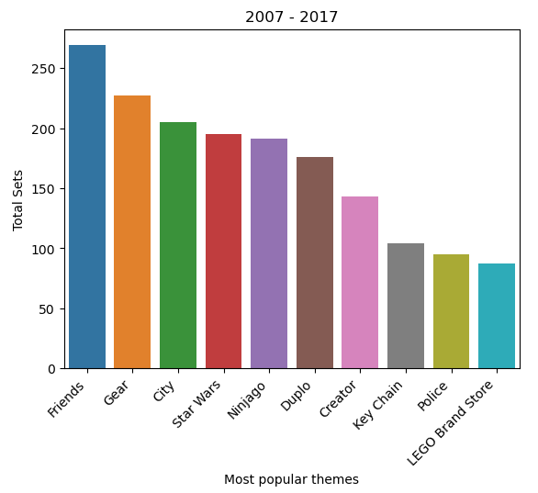
Bestselling themes over time

Slide 6
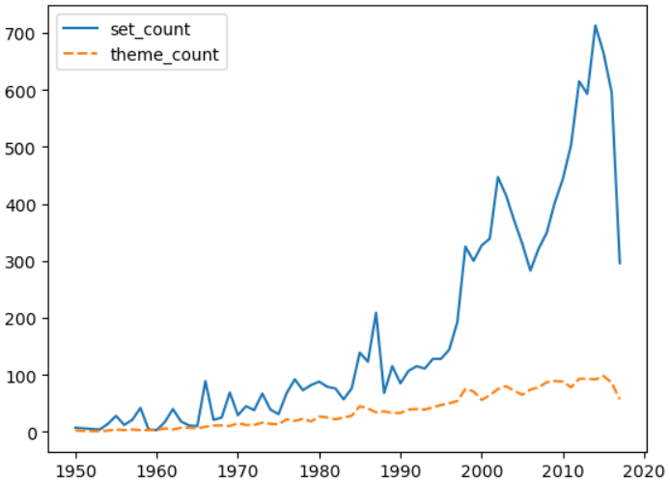
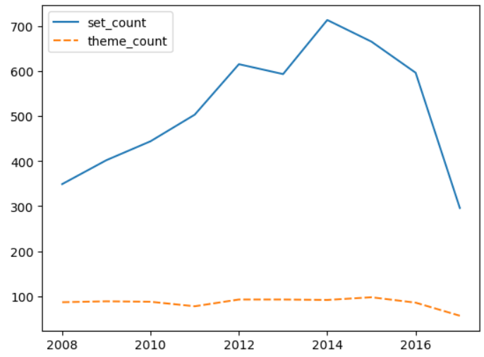
Theme and set growth

Slide 7
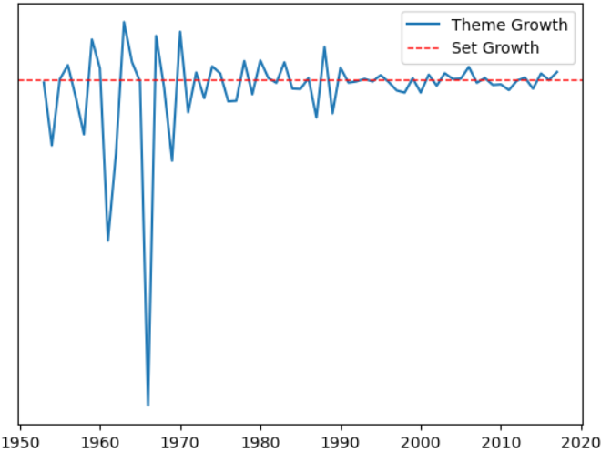
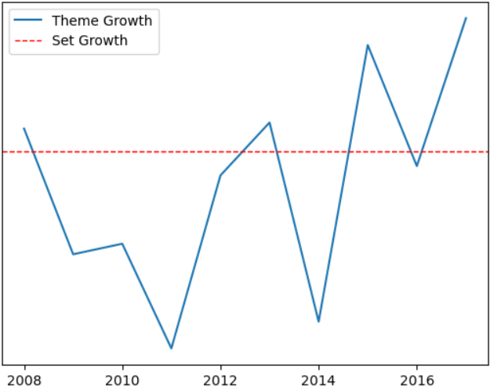
Theme and set growth

Slide 8
Report scope
Dataset goes from 1950 to 2017
Sets produced, no sales info
Focus on themes, not colors or piece shapes or types
Further Questions
Are some themes subsets of each other?
Spiderman and Marvel, Batman and DC
When theme growth outpaces set growth, what are the themes?
Tie in to popular movie releases?

Slide 9
Sources
Dataset sourced from Kaggle
Images sourced from lego.com
Company growth information sourced from statista
Jupyter notebook with data analysis can be found at github

